Slide 1
4. Expectation and Variance Joint PMFs

Slide 2
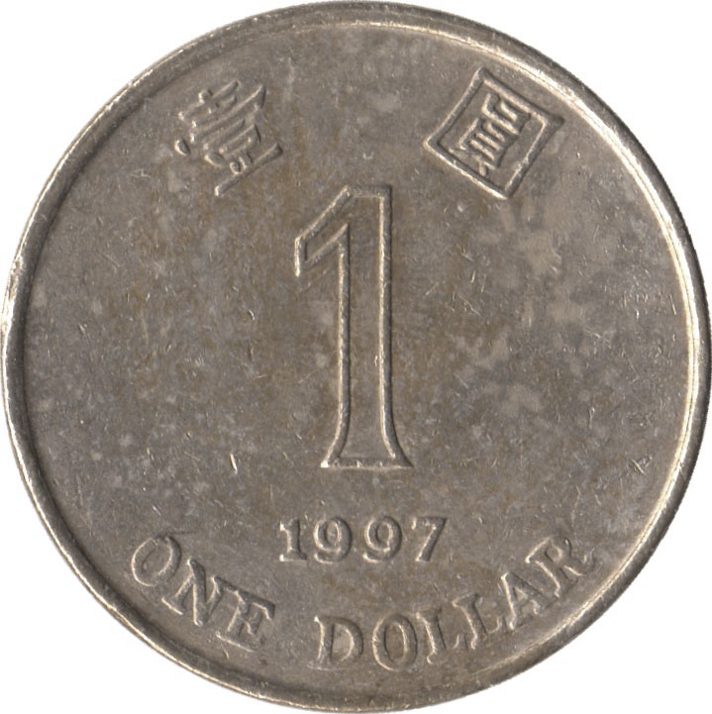
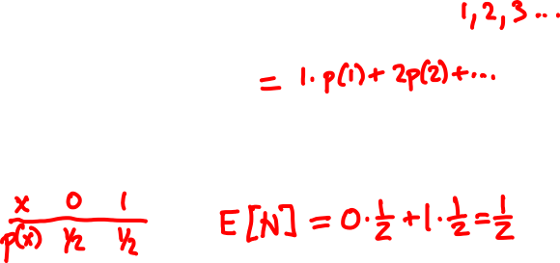
Expected value
The expected value (expectation) of a random variable X with p.m.f. p is
E[X] = ∑_{x} x p(x)
Example
N = number of Hs

Slide 3
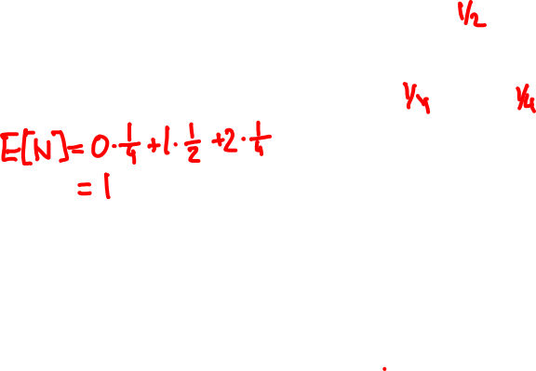
Expected value
Example
N = number of Hs
The expectation is the average value the random variable takes when experiment is done many times

Slide 4
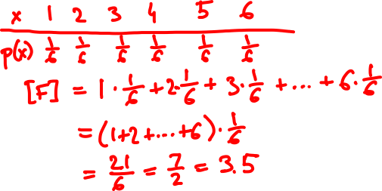
F = face value of fair 6-sided die

Slide 5
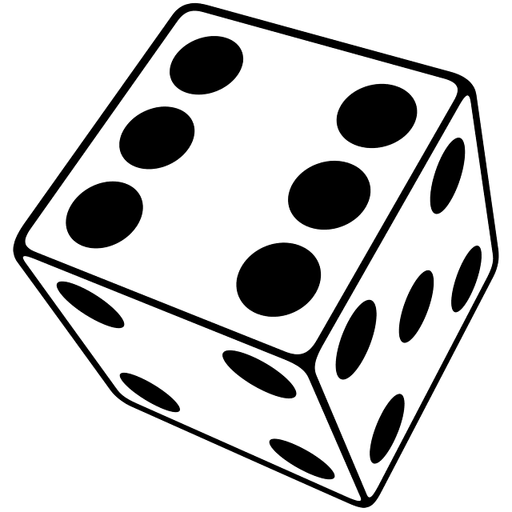
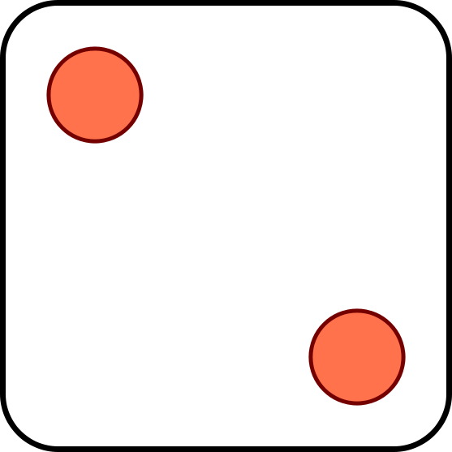
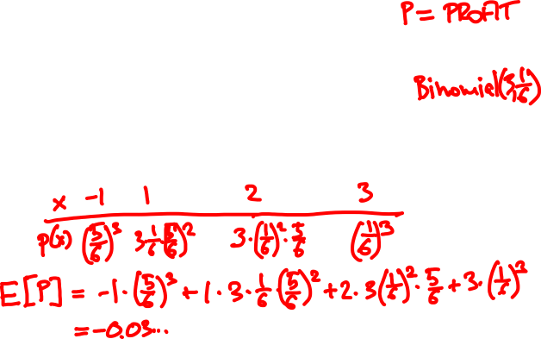
If appears k times, you win $k.
If it doesn’t appear, you lose $1.

Slide 6



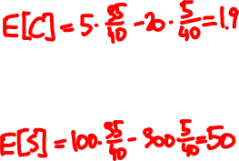
Utility
Should I go to tutorial?
not called
called
+5
-20
Come
+100
-300
Skip
F
35/40
5/40

Slide 7
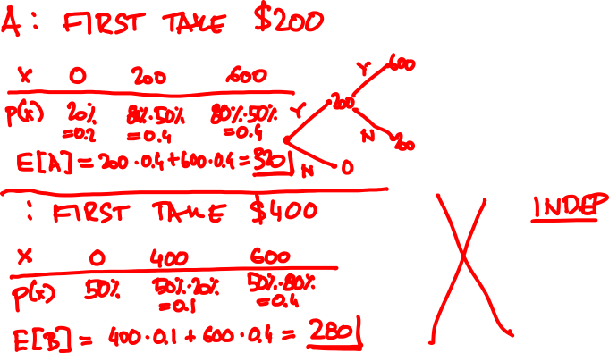
80%
50%

Slide 8

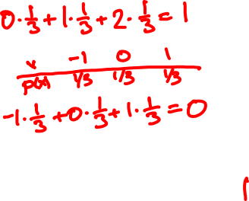
Expectation of a function
x
0 1 2
p.m.f. of X:
p(x)
1/3 1/3 1/3
E[X] =
E[X – 1]=
E[(X – 1)²]=

Slide 9
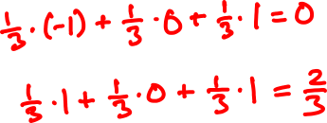
Expectation of a function, again
x
0 1 2
p.m.f. of X:
p(x)
1/3 1/3 1/3
E[X] =
E[X – 1]=
E[(X – 1)²]=
E[f(X)] = ∑_{x} f(x) p(x)

Slide 10

1km
☀️
⛈
🚶🏻‍♀️
🚍
60%
40%
5km/h
30km/h

Slide 11
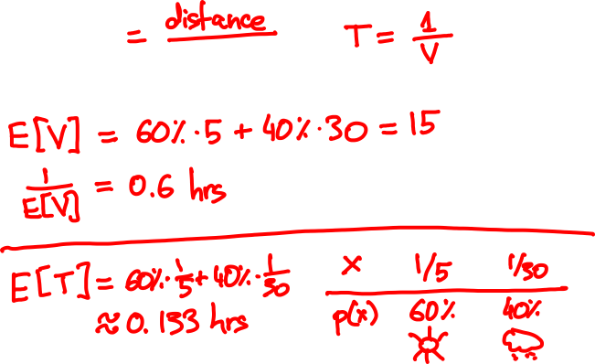
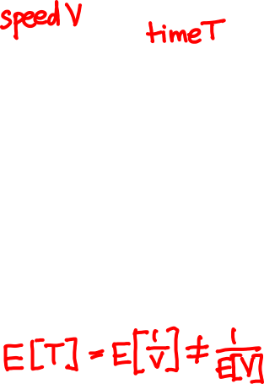

Slide 12
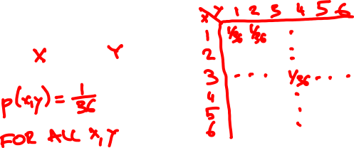
Joint probability mass function
The joint PMF of random variables X, Y is the bivariate function
p(x, y) = P(X = x, Y = y)
Example

Slide 13
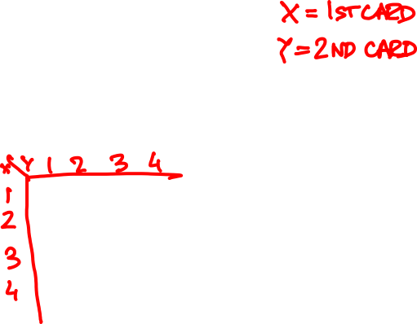
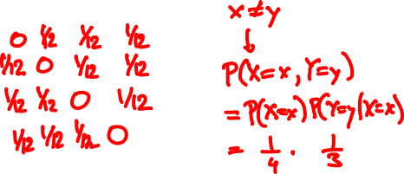
There is a bag with 4 cards:
1
2
3
4
You draw two without replacement. What is the joint PMF of the face values?

Slide 14
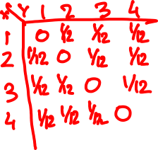
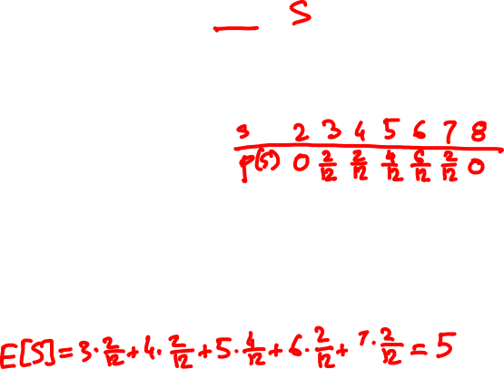
What is the PMF of the sum?
What is the expected value?

Slide 15
PMF and expectation of a function
Z = f(X, Y) has PMF
p_{Z}(z) = ∑_{x, y: f(x, y) = z} p_{XY}(x, y)
and expected value
E[Z] = ∑_{x, y} f(x, y) p_{XY}(x, y)

Slide 16
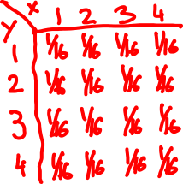
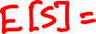
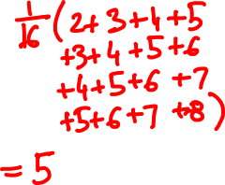
What if the cards are drawn with replacement?

Slide 17
Marginal probabilities
X
1
2
3
4
Y
0 | 1/12 | 1/12 | 1/12
1/12 | 0 | 1/12 | 1/12
1/12 | 1/12 | 0 | 1/12
1/12 | 1/12 | 1/12 | 0
1/4
1/4
1/4
1/4
1
2
P(Y = y) = ∑_{x} P(X = x, Y = y)
3
4
1/4 | 1/4 | 1/4 | 1/4
1
P(X = x) = ∑_{y} P(X = x, Y = y)

Slide 18
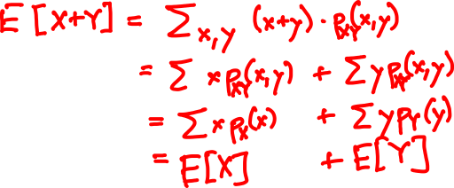
Linearity of expectation
For every two random variables X and Y
E[X + Y] = E[X] + E[Y]

Slide 19
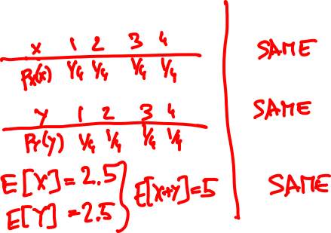


Slide 20
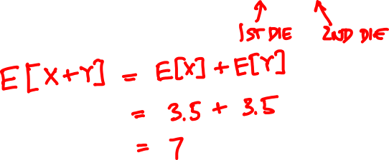
E[X + Y] = ?

Slide 21
The indicator (Bernoulli) random variable
Perform a trial that succeeds with probability p and fails with probability 1 – p.
x
0 1
p(x)
p(x)
1 – p p
p = 0.5
If X is Bernoulli(p) then
E[X] = p
p(x)
p = 0.4

Slide 22
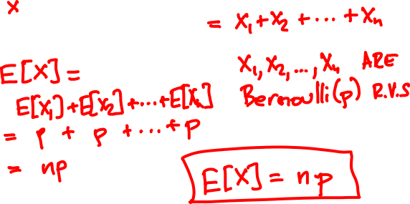
Mean of the Binomial
Binomial(n, p): Perform n independent trials, each of which succeeds with probability p.
X = number of successes

Slide 23
Binomial(10, 0.5)
Binomial(50, 0.5)
Binomial(10, 0.3)
Binomial(50, 0.3)

Slide 24

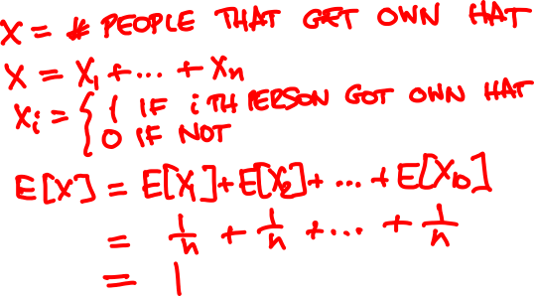
n people throw their hats in a box and pick one out at random. How many on average get back their own?

Slide 25
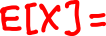
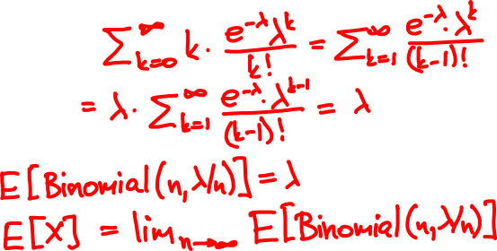
Mean of the Poisson
Poisson(λ) approximates Binomial(n, λ/n) for large n
p(k) = e^{-λ} λ^{k}/k!
k = 0, 1, 2, 3, …

Slide 26


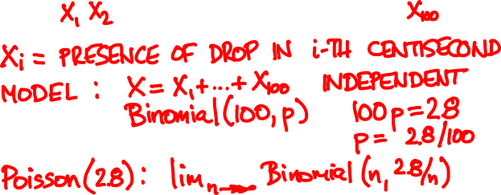
Raindrops
Rain is falling on your head at an average speed of 2.8 drops/second.
0
1

Slide 27
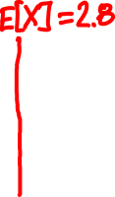
Raindrops
0
1
Number of drops N is Binomial(n, 2.8/n)

Slide 28

Rain falls on you at an average rate of 3 drops/sec.
When 100 drops hit you, your hair gets wet.
You walk for 30 sec from MTR to bus stop.
What is the probability your hair got wet?

Slide 29
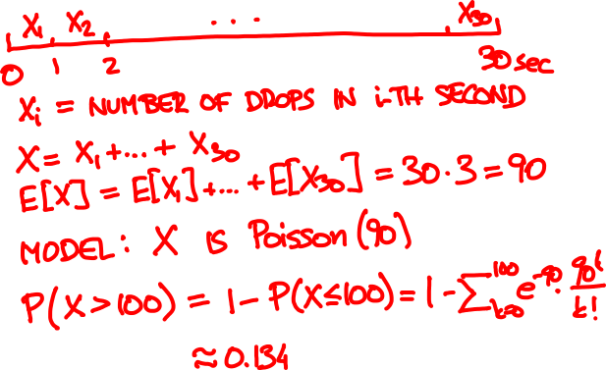

Slide 30
Investments
You have three investment choices:
A: put $25 in one stock
B: put $½ in each of 50 unrelated stocks
C: keep your money in the bank
Which do you prefer?

Slide 31
Investments
Probability model
doubles in value with probability ½
Each stock
loses all value with probability ½
Different stocks perform independently

Slide 32
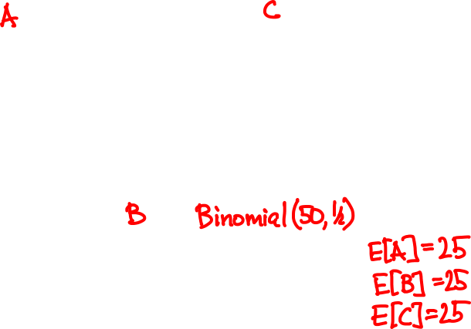

Slide 33
Variance and standard deviation
Let μ = E[X] be the expected value of X.
The variance of X is the quantity
Var[X] = E[(X – μ)²]
The standard deviation of X is σ = √Var[X]
It measures how close X and μ are typically.

Slide 34
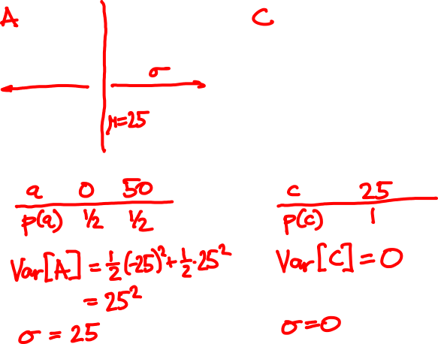

Slide 35
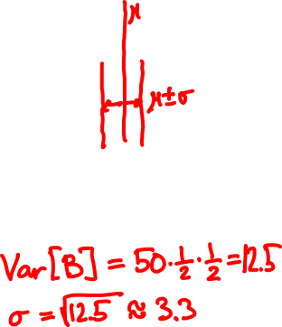
Var[Binomial(n, p)] = np(1 – p)

Slide 36
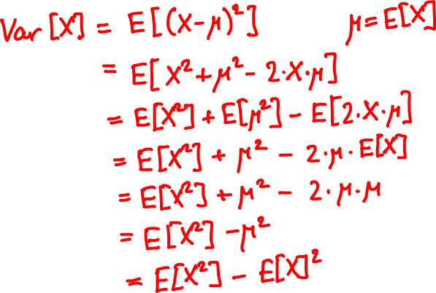
Another formula for variance

Slide 37
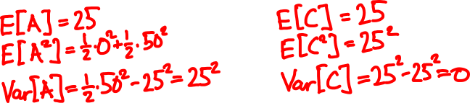
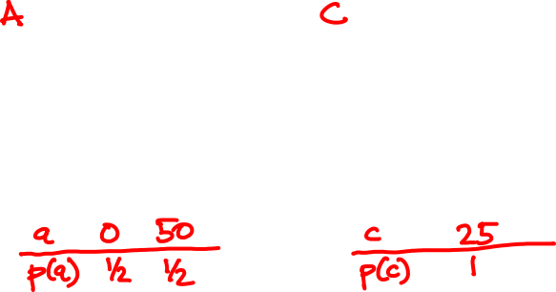

Slide 38
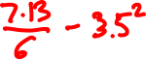
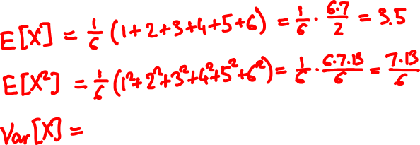
E[X] = ?
Var[X] = ?

Slide 39

In 2011 the average household in Hong Kong had 2.9 people.
Take a random person. What is the average number of people in his/her household?
A: < 2.9
B: 2.9
C: > 2.9

Slide 40








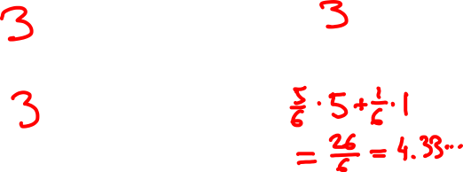
average household size
average size of random person’s household

Slide 41
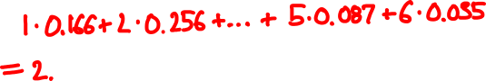
What is the average household size?
household size 1 2 3 4 5 more
% of households 16.6 25.6 24.4 21.2 8.7 3.5
From Hong Kong Annual Digest of Statistics, 2012
Probability model 1
Households under equally likely outcomes
X = number of people in the household
E[X] =
Notes:
2.7

Slide 42
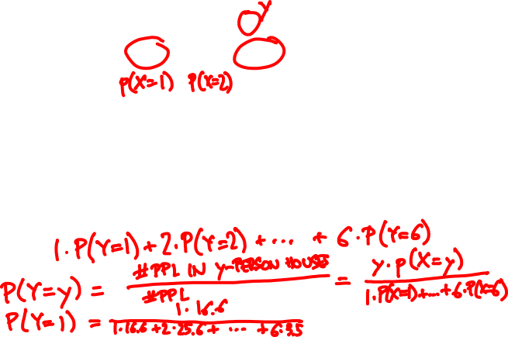
What is the average household size?
household size 1 2 3 4 5 more
% of households 16.6 25.6 24.4 21.2 8.7 3.5
Probability model 2
People under equally likely outcomes
Y = number of people in the household
E[Y] =
Notes:
3.521

Slide 43
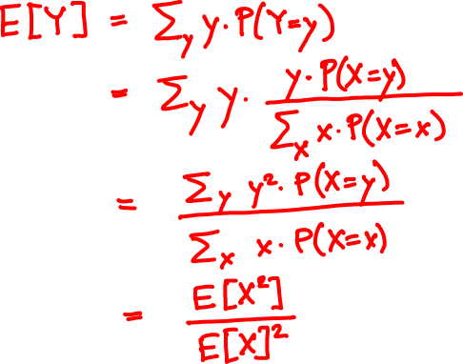
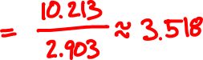

Slide 44
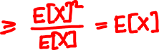
Summary
X = number of people in a random household
Y = number of people in household of a random person
E[X²]
E[Y]
=
E[X]
Because Var[X] ≥ 0,
E[X²] ≥ (E[X])²
So E[Y] ≥ E[X]. The two are equal only if all households have the same size.

